Slide 1


HIRING
PROCESS ANALYTICS
Presented by: Pranav Jadhav

Slide 2

CONTENT
01
02
03
Project Description
Tech stack used
Approach
04
05
Analysis
Insights

Slide 3



PROJECT DESCRIPTION
Analyzing the previous Hiring dataset of MNC, finding trends and insights from the dataset helpful for the Hiring Department.
The Dataset consists of the details about the people registered for the particular posts in the company.
Using statistical Knowledge and Excel formulas to find the conclusion for the company

Slide 4


TECH STACK USED
Microsoft Excel 2016

Slide 5



APPROACH
For this project, I have used Microsoft Excel 2016 to work with the data provided. There were some missing data into the event_name, post_name and salary columns.
I have Handled Missing valuse, removed the Outliers, and used pivot table and various charts to draw the conclusion from the data

Slide 6


ANALYSIS

Slide 7

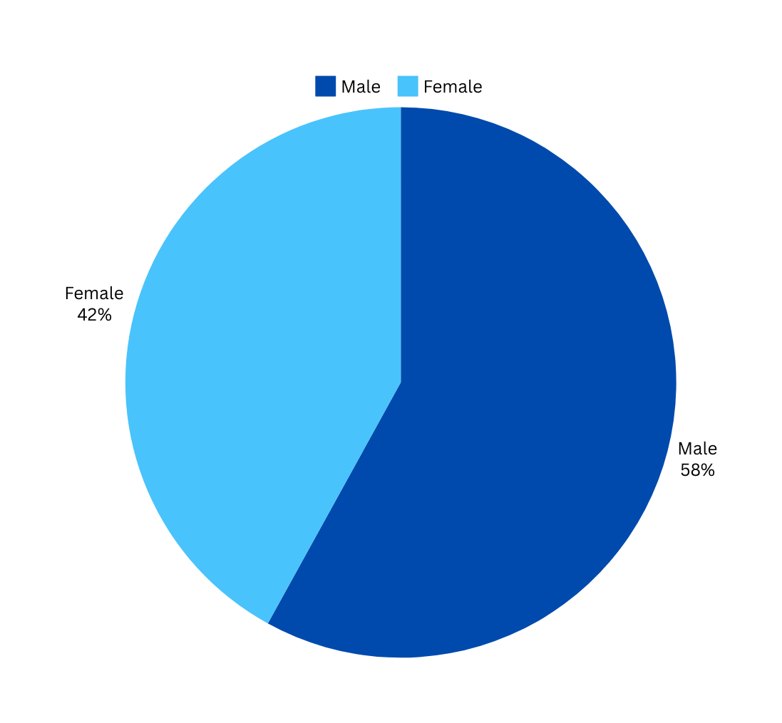
Hiring
Analysis
Determine the gender distribution of hires. How many males and females have been hired by the company?
Male | 2562
Female | 1854

Slide 8
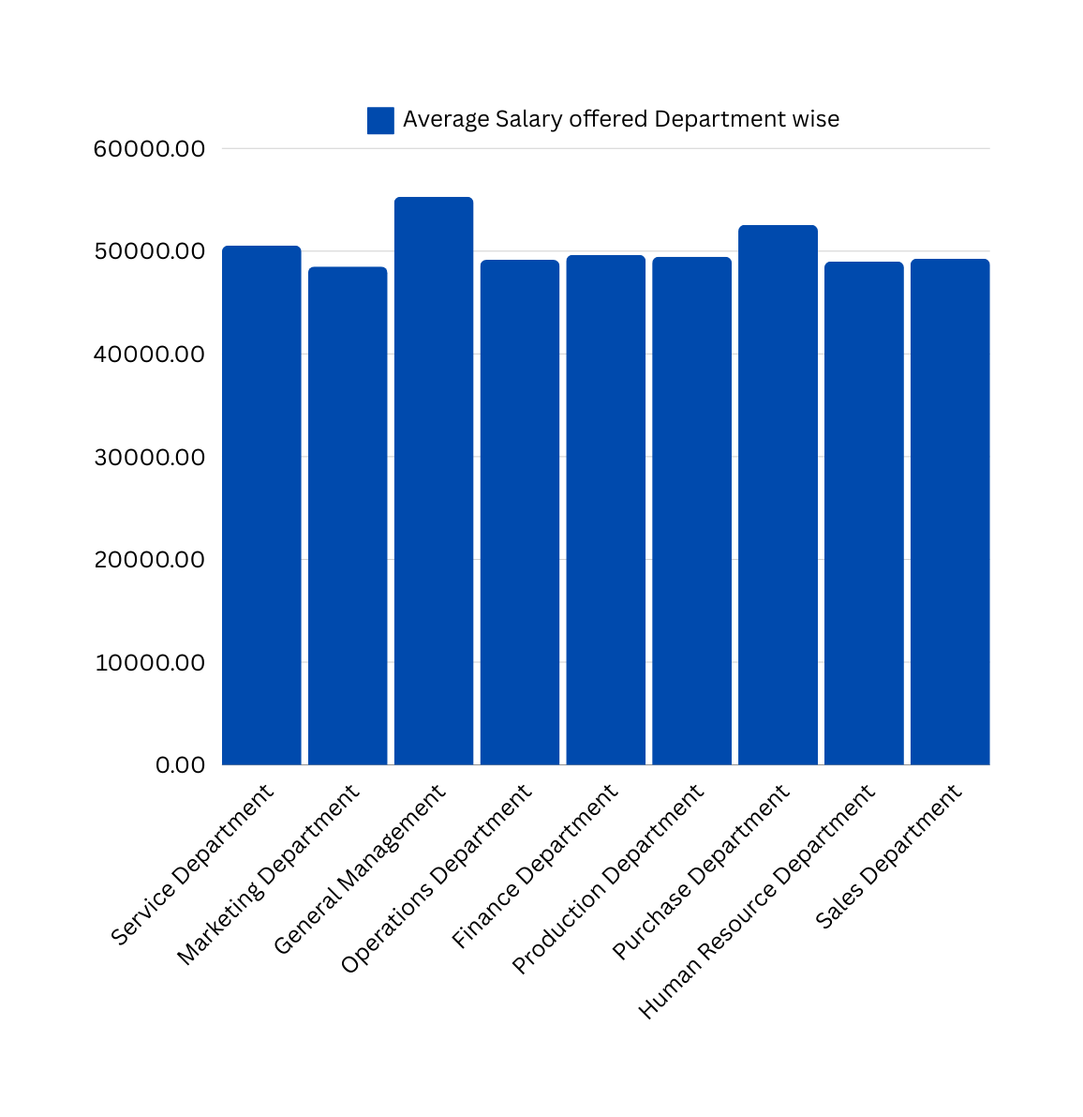
Salary
Analysis
What is the average salary offered by this company? Use Excel functions to calculate this.
Average Slary offerd by the company
49874.7

Slide 9
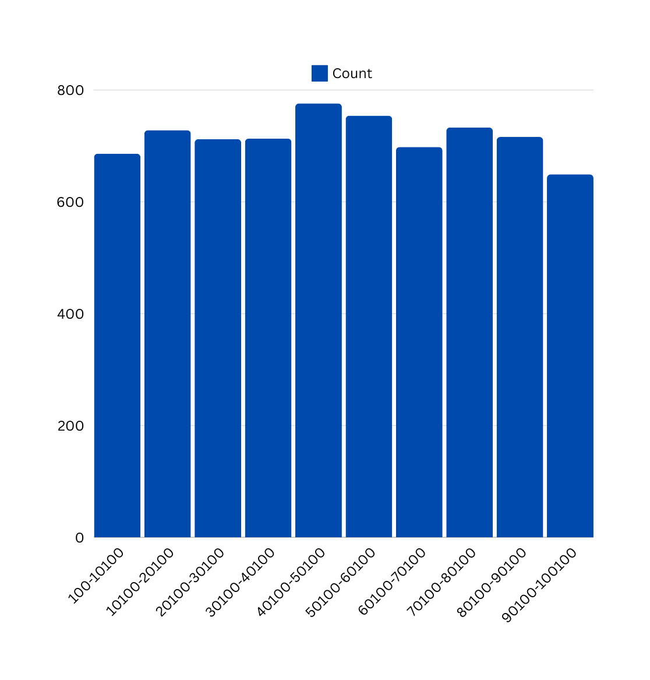
Salary Distribution
Create class intervals for the salaries in the company. This will help you understand the salary distribution.
Salary Range | Count
100-10100 | 686
10100-20100 | 728
20100-30100 | 712
30100-40100 | 713
40100-50100 | 776
50100-60100 | 754
60100-70100 | 698
70100-80100 | 733
80100-90100 | 716
90100-100100 | 649

Slide 10
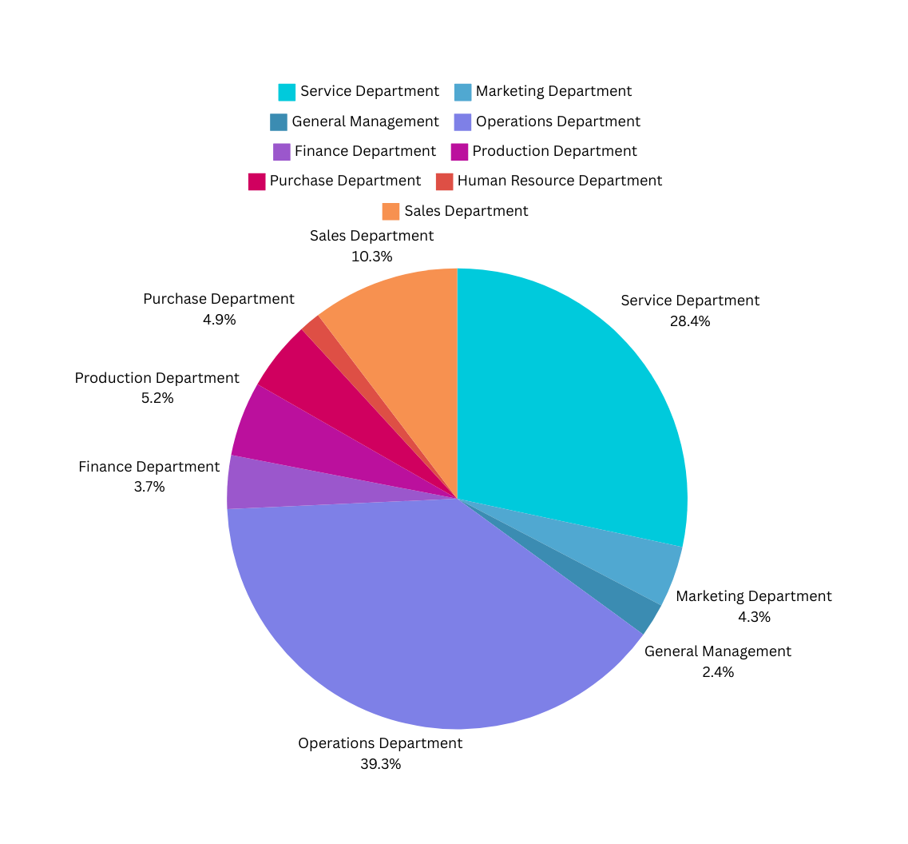
Departmental Analysis
Use a pie chart, bar graph, or any other suitable visualization to show the proportion of people working in different departments.
Department | Count
Service Department | 1331
Marketing Department | 202
General Management | 111
Operations Department | 1843
Finance Department | 176
Production Department | 246
Purchase Department | 230
Human Resource Department | 70
Sales Department | 485

Slide 11
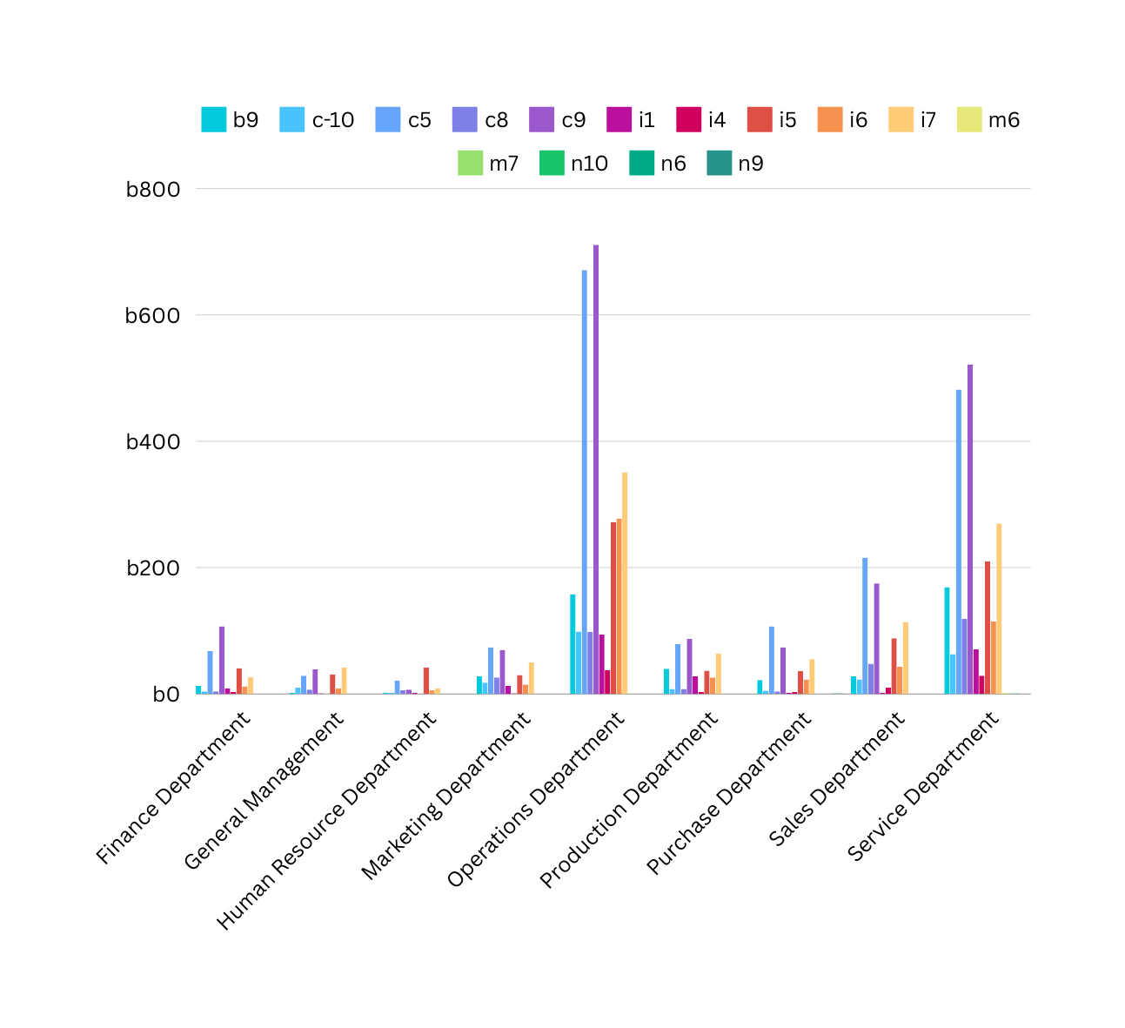
Position Tier Analysis
Use a chart or graph to represent the different position tiers within the company. This will help you understand the distribution of positions across different tiers.
The table for the beside graph can be seen in the excel sheet provided in next slide

Slide 12


EXCEL SHEET LINK
https://docs.google.com/spreadsheets/d/1T7neuVIHIJTnhKXstpkEUF-i5sKTj1Gj/edit?usp=sharing&ouid=117046160201599489244&rtpof=true&sd=true

Slide 13

INSIGTHS
In this , project I learned how to apply Excel formulas and piovt tables and statitics in excel as well. It helped me in mastering my statistics and excel concepstand use it to derice the valuable insighsts which help to answer the questions.

Slide 14

Thankyou

